Slide 1
NETWORKING

Slide 2
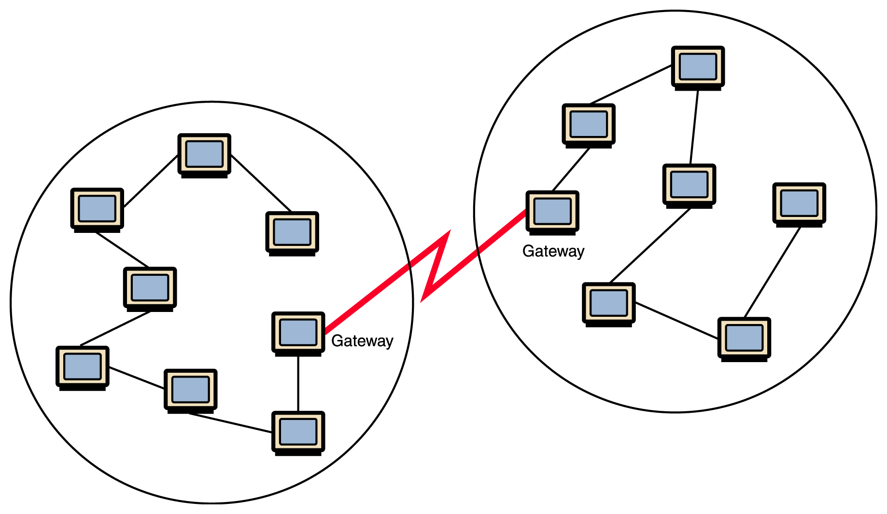
NETWORK:
A network consists of two or more computers that are linked in order to share resources (such as printers and CDs), exchange files, or allow electronic communications.

Slide 3
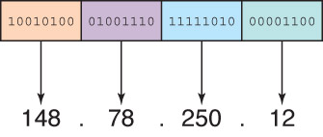
IP Addresses
An IP address can be split into
network address, which specifies a specific network
host number, which specifies a particular machine in that network

Slide 4
Dynamic Ip : A dynamic IP address is a temporary address for devices connected to a network that continually changes over time.
Static IP : If your computer is hosting a web server, its IP address is what identifies it to the rest of the Internet. A computer on the Internet can have a static IP address, which means it stays the same over time.
DHCP : Dynamic Host Configuration Protocol (DHCP) is a client/server protocol that automatically provides an Internet Protocol (IP) host with its IP address and other related configuration information such as the subnet mask and default gateway

Slide 5
IPv4 and IPv6 :
IPv4 is the protocol using 32-bit addresses. It has been officially used since 1977
IPv6 is a new protocol (defined in 1996) using 128-bit addresses. The Internet is in the process of transitioning to IPv6
Types of Distribution methods:
Class Full Distribution Method
Class Less Inter Domain Routing (CIDR)

Slide 6
Class Full Distribution Method:
In classful routing, address is divided into three parts which are: Network, Subnet and Host
Class Less Inter Domain Routing (CIDR):
In classless routing, address is divided into two parts which are: Subnet and Host

Slide 7
Types Of Classes
Class A: (0-126)
Network.Host.Host.Host (N.H.H.H)
A.256x256x256 = 16,777,216
Class B: (128-191)
Network.Network.Host.Host (N.N.H.H)
A.B.256X256 = 65,536
Class C: (192-223)
Network.Network.Nerwork.Host (N.N.N.H)
A.B.C.256 = 256
Class D: (224-239)
Class D addresses are used for multicasting applications.
Class E: (224-239)
This IP Class is reserved for experimental purposes only for R&D or Study

Slide 8
CIDR:
It’s a block of IP address
a . b . c .d / n
n = value of CIDR
Standard IP address = 2^x
X= 0,1,2,3,4,5…..
Standard IP will be equal to 2^(32-n)
2^x=2^(32-n)
x=32-n
n=32-x

Slide 9
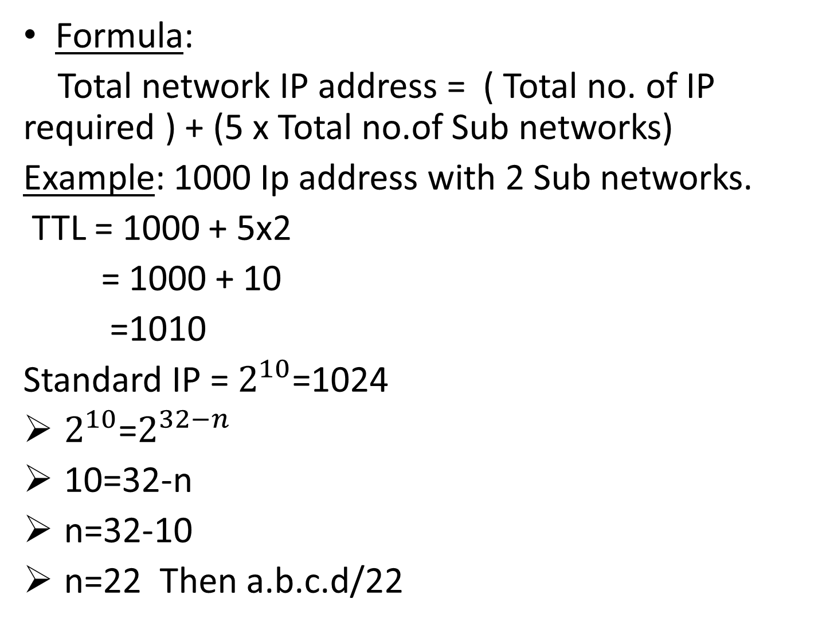
Formula:
Total network IP address = ( Total no. of IP required ) + (5 x Total no.of Sub networks)
Example: 1000 Ip address with 2 Sub networks.
TTL = 1000 + 5x2
= 1000 + 10
=1010
Standard IP = $2^{10}$=1024
$2^{10}$=$2^{32−n}$
10=32-n
n=32-10
n=22 Then a.b.c.d/22

Slide 10
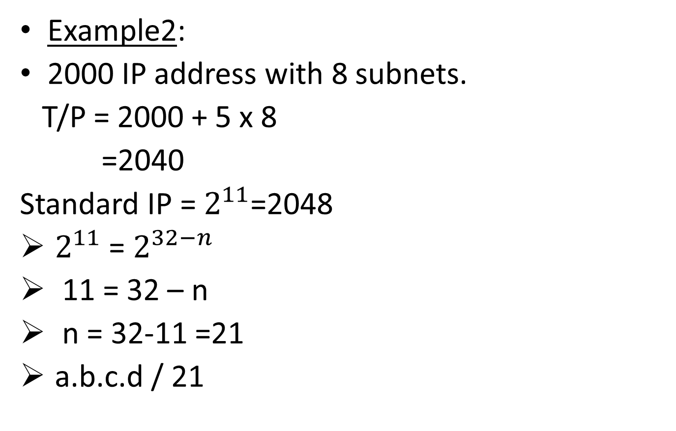
Example2:
2000 IP address with 8 subnets.
T/P = 2000 + 5 x 8
=2040
Standard IP = $2^{11}$=2048
$2^{11}$ = $2^{32−n}$
11 = 32 – n
n = 32-11 =21
a.b.c.d / 21

Slide 11
Azure Virtual Network (V-Net)

Slide 12
Azure Virtual Network (VNet) is the fundamental building block for your private network in Azure. VNet enables many types of Azure resources, such as Azure Virtual Machines (VM), to securely communicate with each other, the internet, and on-premises networks.

Slide 13
A subnet is a range of IP addresses in the virtual network. You can divide a virtual network into multiple subnets for organization and security. Each NIC in a VM is connected to one subnet in one virtual network.

Slide 14
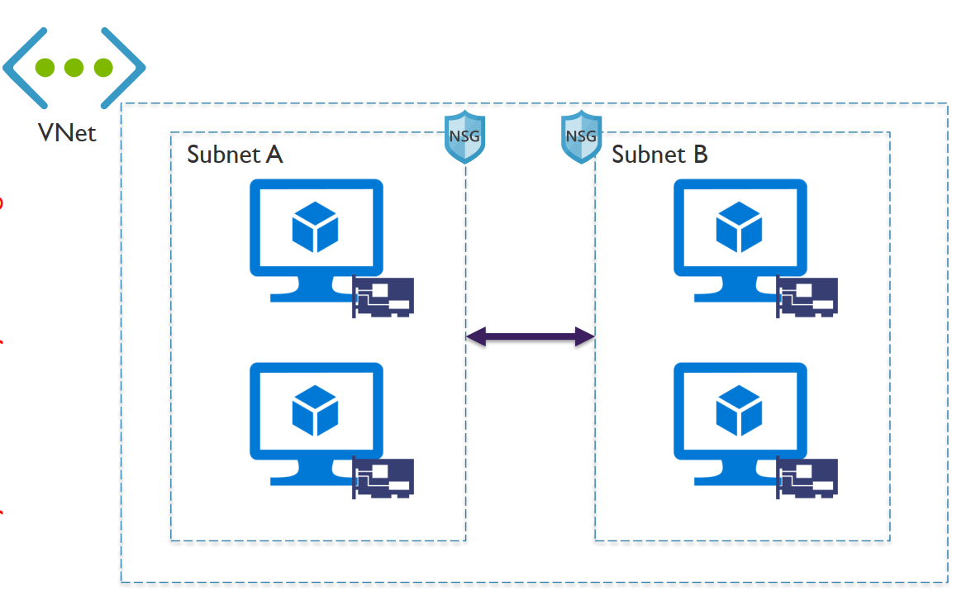

Slide 15

Network Security Group (NSG):
Network Security Group is a access control rules that provide advanced security for Azure virtual machines.
It controls inbound and outbound traffic passing a NIC (Network Interface Card), a virtual machine (classic deployment model), or a subnet(both deployment models)

Slide 16
NIC (Network Interface Card):
NIC is assigned with IP address and associate with NSG Rules , Which is used for the communication between virtual machines or internal network or internet.
Service Endpoints:
It is a feature of virtual network . Which you want to restrict service from a Virtual Network is called Service Endpoints.
Only selected Subnet is access and other Vnet will get restricted from that service.

Slide 17
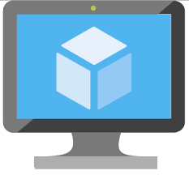
Azure Virtual Machine
Virtual Machine:
Virtual Machine are compute instances (machines) in cloud. Where the networking and Hardware's is taken care by the provider.
a virtual machine behaves like a server: It is a computer within a computer that provides the user the same experience they would have on the host operating system itself

Slide 18
Design Parameters of a V/M
1. DISK Size:
Standard HDD
Standard SSD
Primium (I/O’S)
Managed Disk: Managed by Microsoft
Unmanaged Disk: Customer Managed of the storage

Slide 19
2. High Availability:
A high availability cluster is a group of servers that act as a single server to provide continuous uptime. These servers will have access to the same shared storage for data, so if a server is unavailable, the other servers pick up the load.
High Availability Two types in Azure.
1. Availability Set
2. Availability Zone

Slide 20
1. Availability Set
Availability set:
It is a logical boundary to maintain servers High availability with the help of Fault Domain and Update Domain .
1.Fault Domain :
It is a group of Virtual Machines. Which share common power source and network switch
Each Fault Domain contains some Racks .
Each Rack contain Virtual Machines.
2. Update Domain:
Virtual Machine get update domains automatically once they put inside Availability Set
All the Virtual Machines within that updated Domain will reboot together.
It is used for Patching Virtual Machines

Slide 21
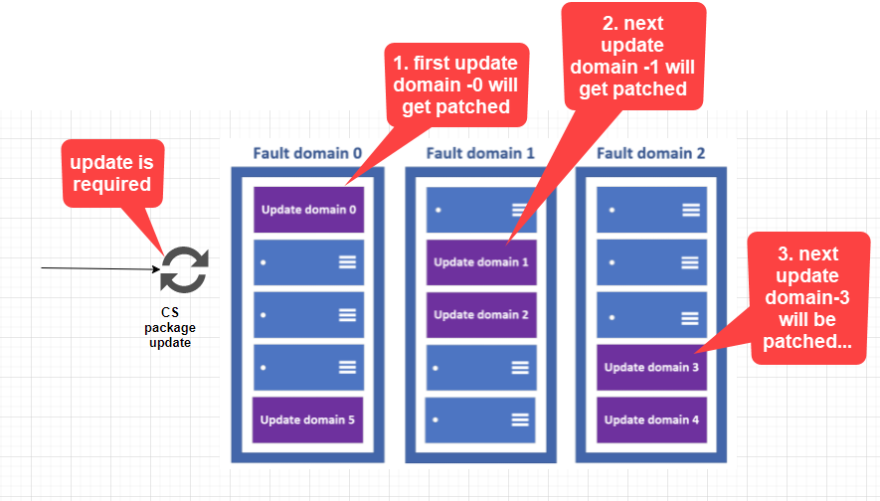
Availability Set Diagram

Slide 22
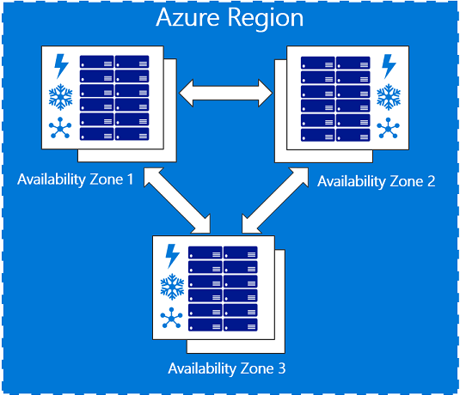
2. Availability Zone
Availability Zone :
Region with Multiple data center’s are Availability Zones

Slide 23
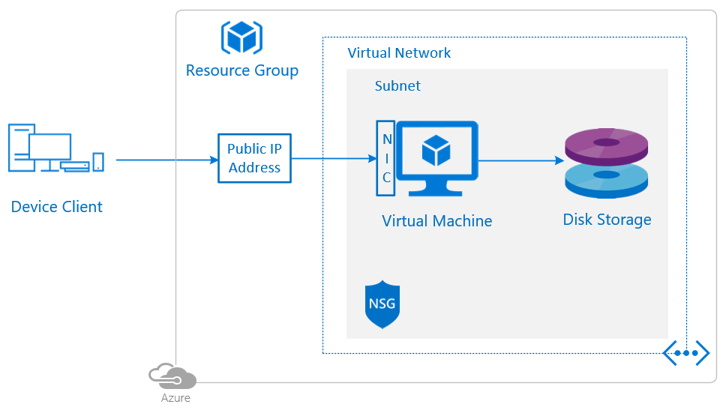
Lab1: Create Virtual Machine
Enter virtual machines in the search.
Under Services, select Virtual machines.
In the Virtual machines page, select Create and then Azure virtual machine. The Create a virtual machine page opens.

Slide 24
Lab1:Create Virtual Machine
Enter virtual machines in the search.
Under Services, select Virtual machines.
In the Virtual machines page, select Create and then Azure virtual machine. The Create a virtual machine page opens.
Under Instance details, enter myVM for the Virtual machine name and choose Windows Server 2019 Datacenter - Gen 2 for the Image. Leave the other defaults.

Slide 25
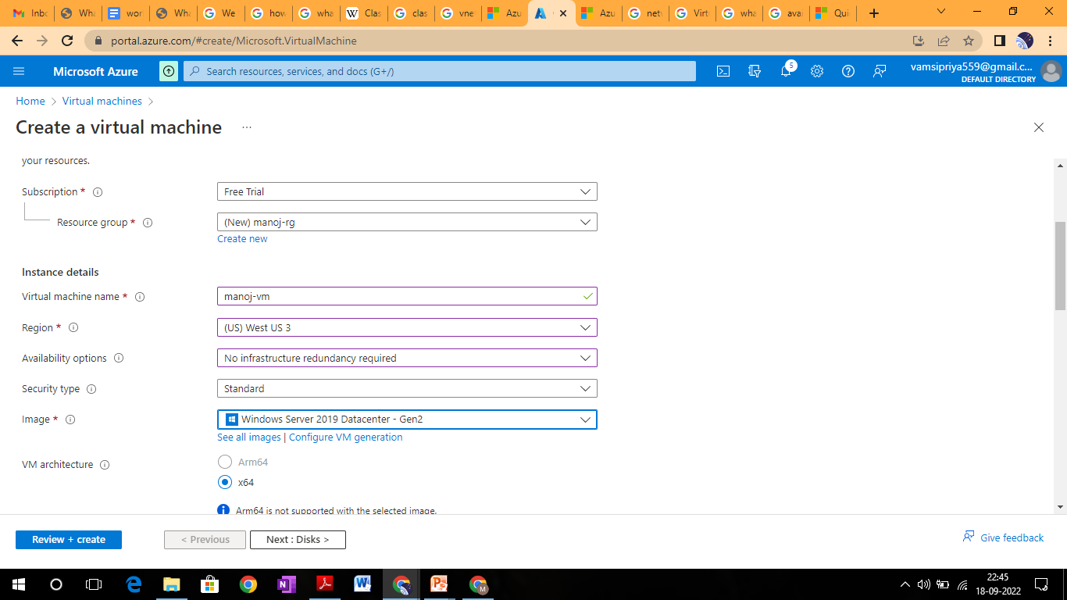

Slide 26
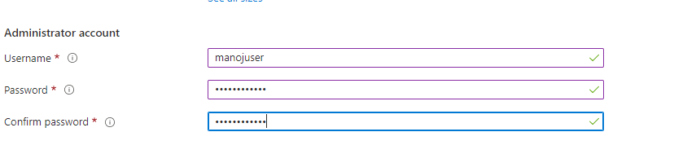
Under Administrator account, provide a username, such as manojuser and a password. The password must be at least 12 characters

Slide 27
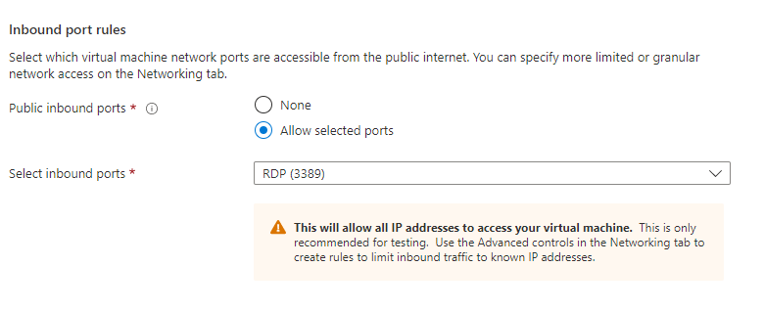
Under Inbound port rules, choose Allow selected ports and then select RDP (3389) and HTTP (80) from the drop-down.

Slide 28
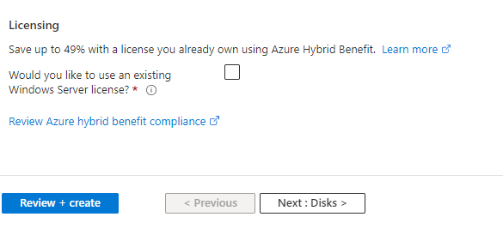
Leave the remaining defaults and then select the Review + create button at the bottom of the page.

Slide 29
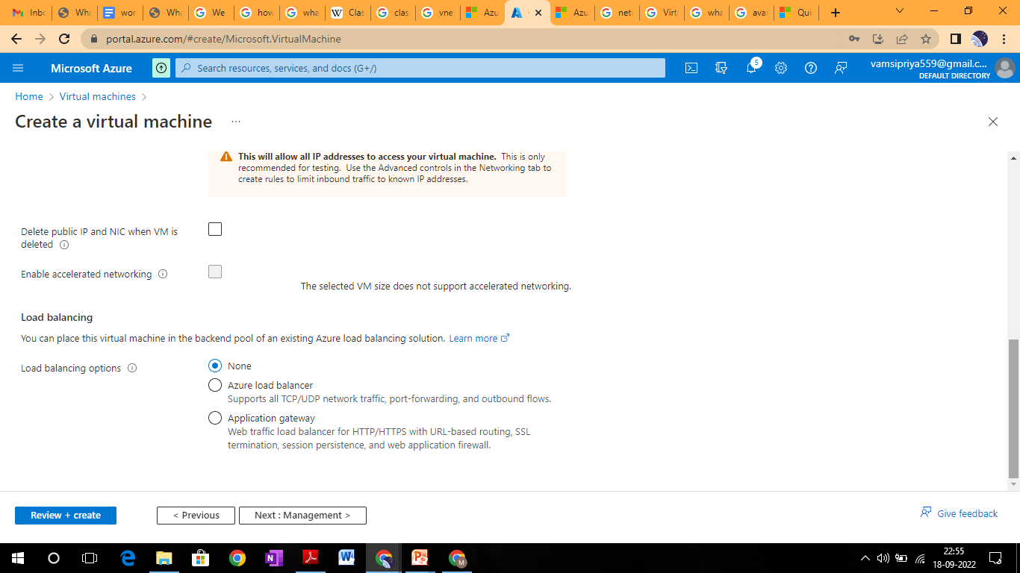

Slide 30
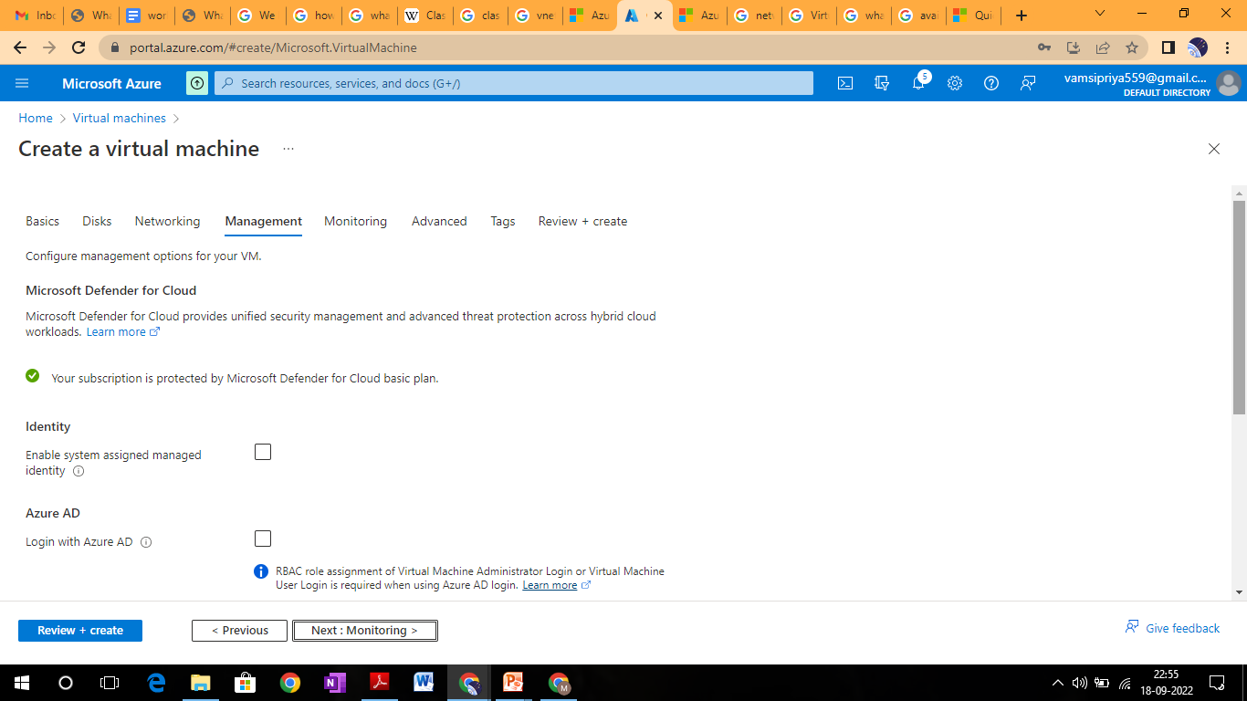

Slide 31
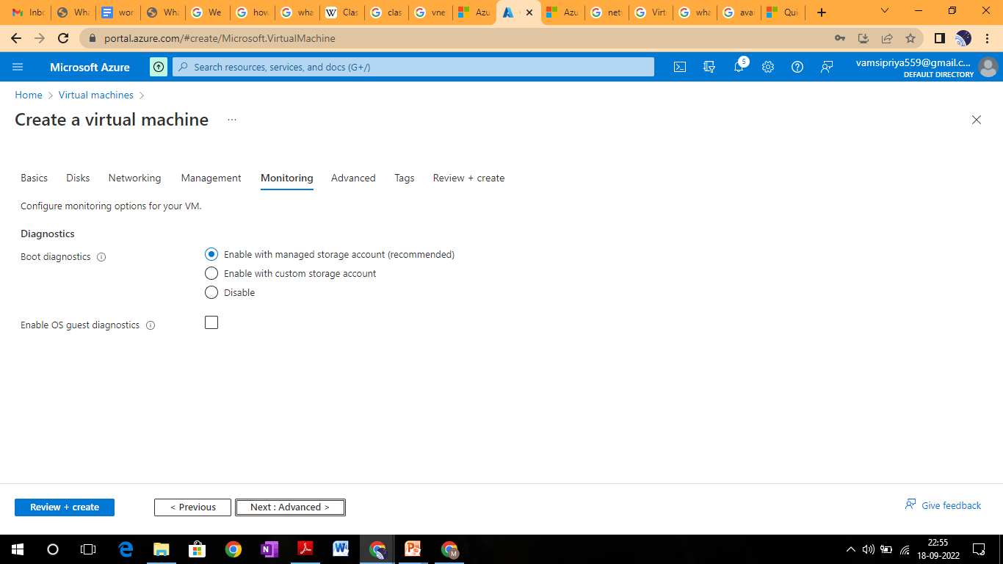

Slide 32
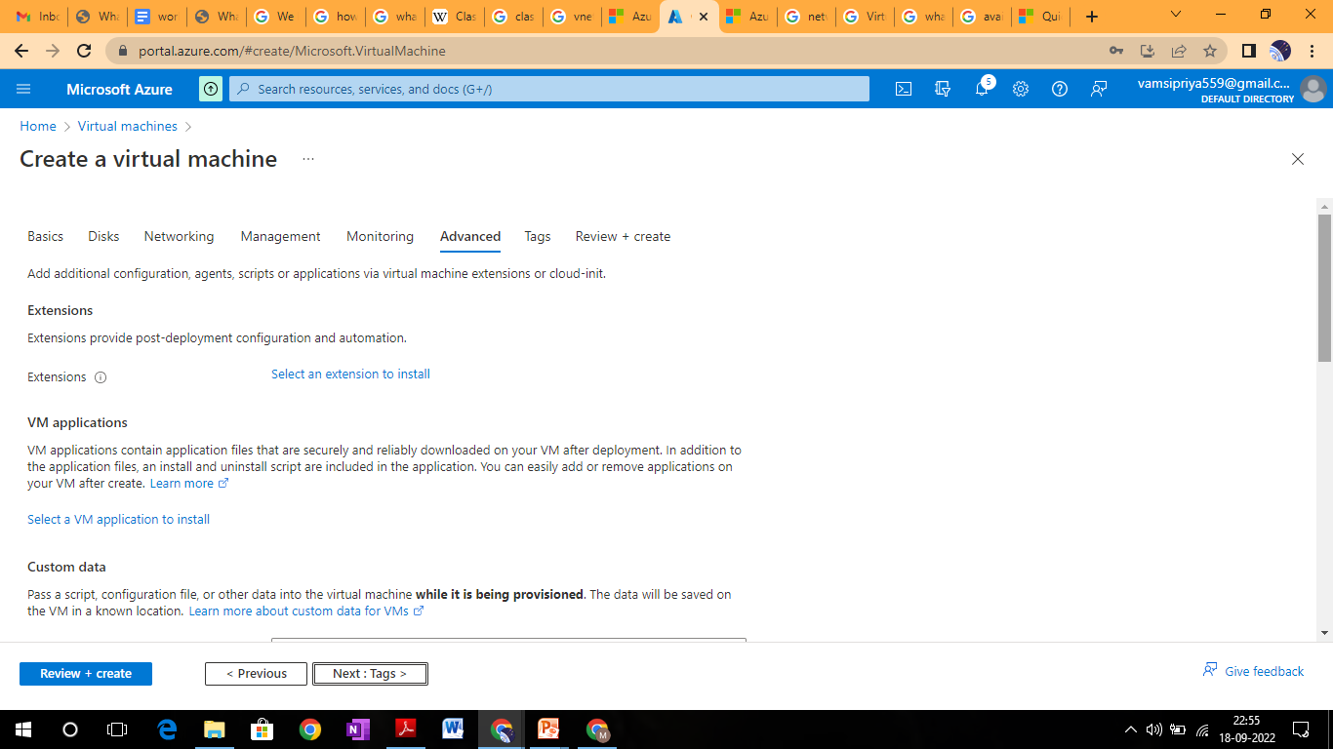

Slide 33
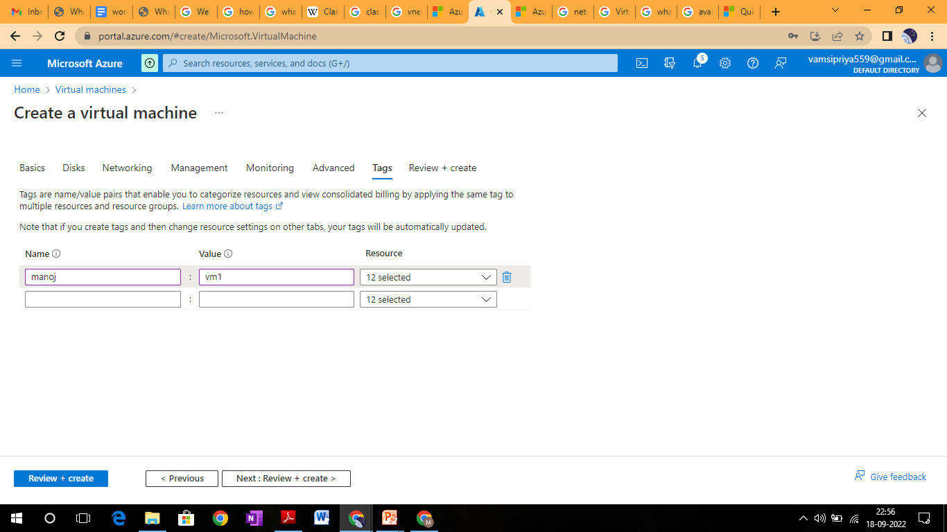

Slide 34
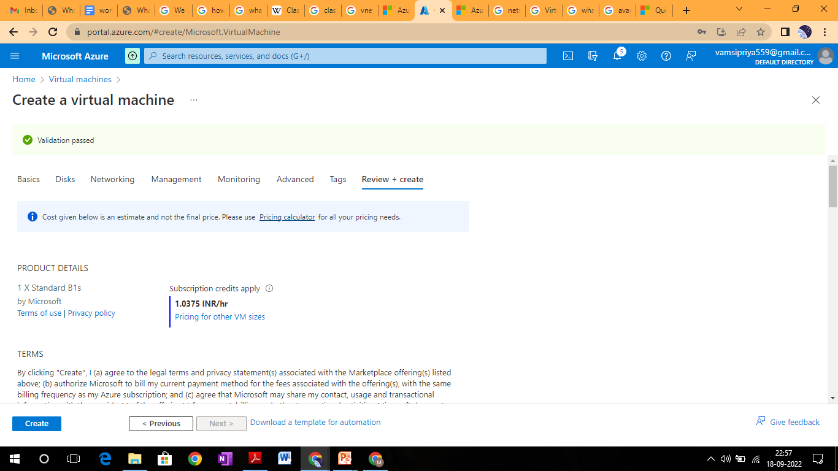
After validation runs, select the Create button at the bottom of the page.

Slide 35
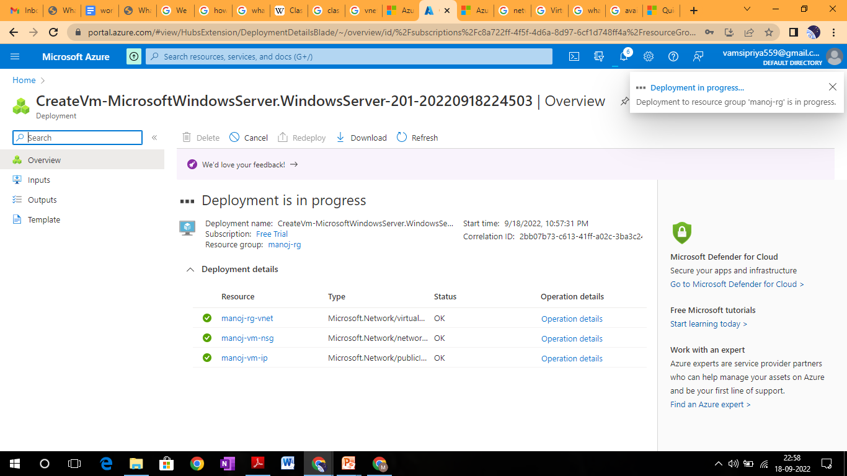
After deployment is complete, select Go to resource.

Slide 36
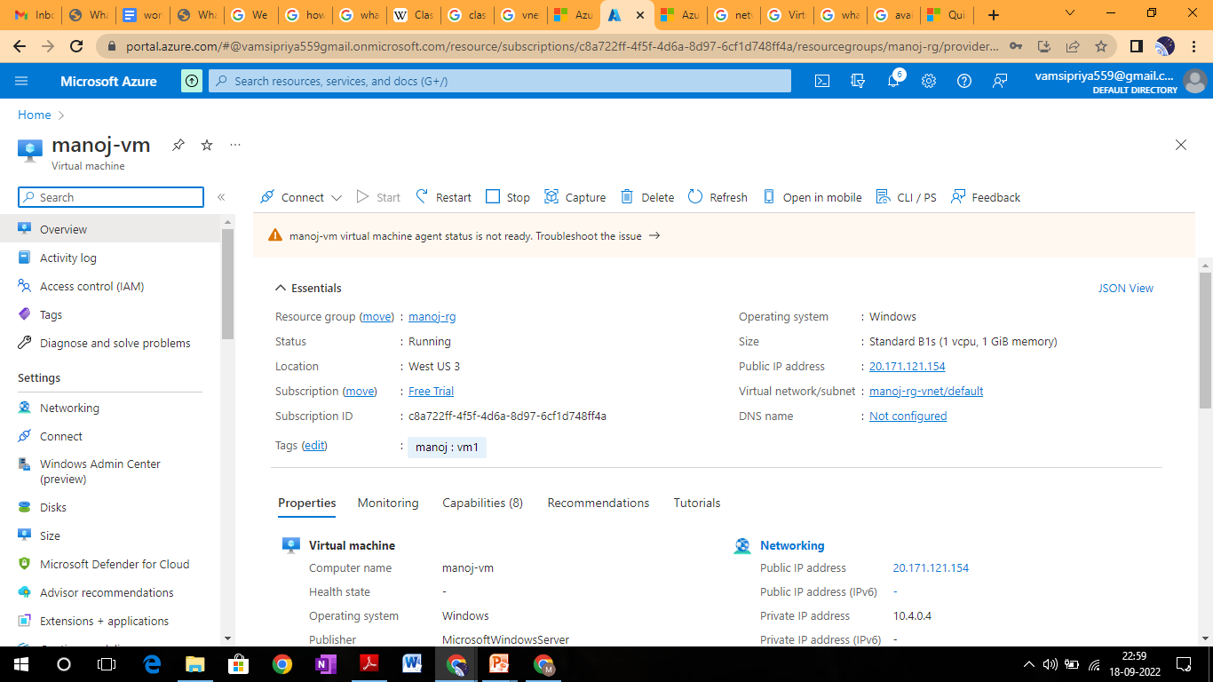
Connect to Virtual Machine
On the overview page for your virtual machine, select the Connect > RDP.

Slide 37
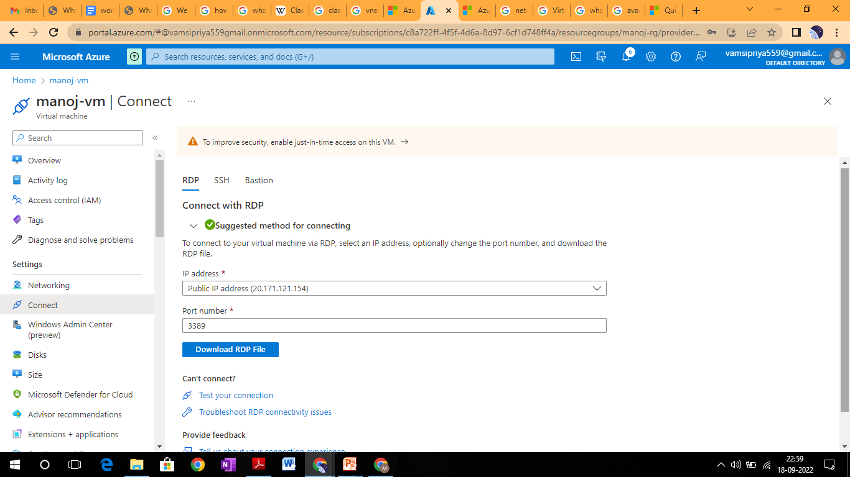
In the Connect with RDP tab, keep the default options to connect by IP address, over port 3389, and click Download RDP file.

Slide 38
Open the downloaded RDP file and click Connect when prompted.
In the Windows Security window, select More choices and then Use a different account. Type the username as localhost\username, enter the password you created for the virtual machine, and then click OK.
You may receive a certificate warning during the sign-in process. Click Yes or Continue to create the connection.

Slide 39
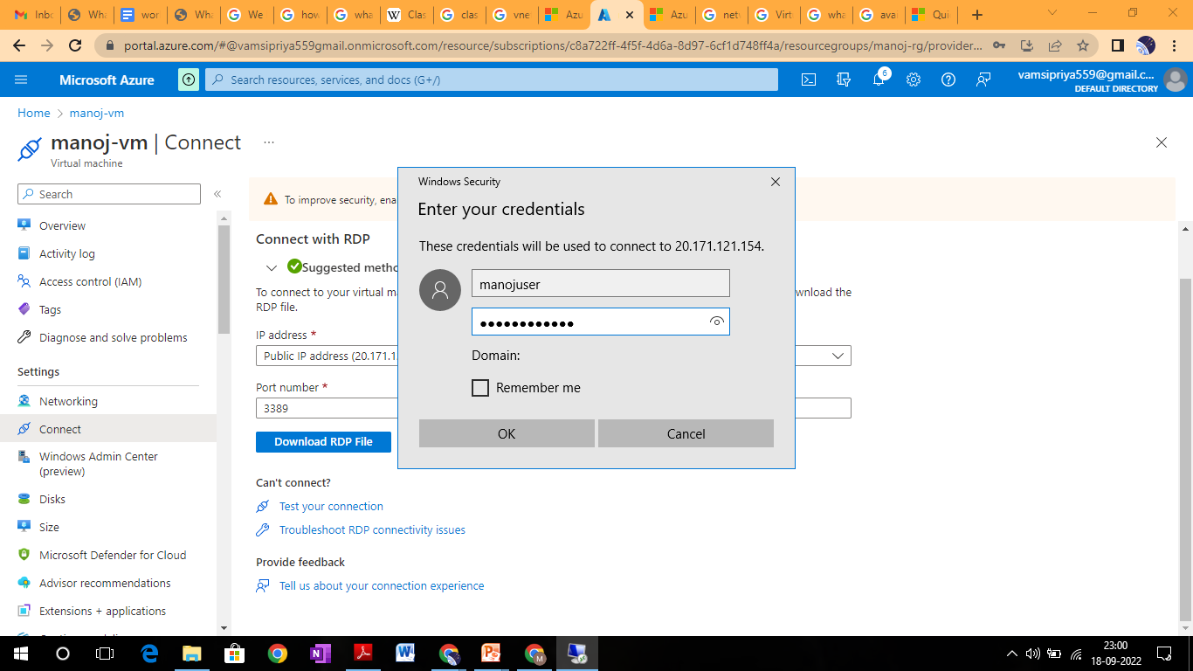

Slide 40
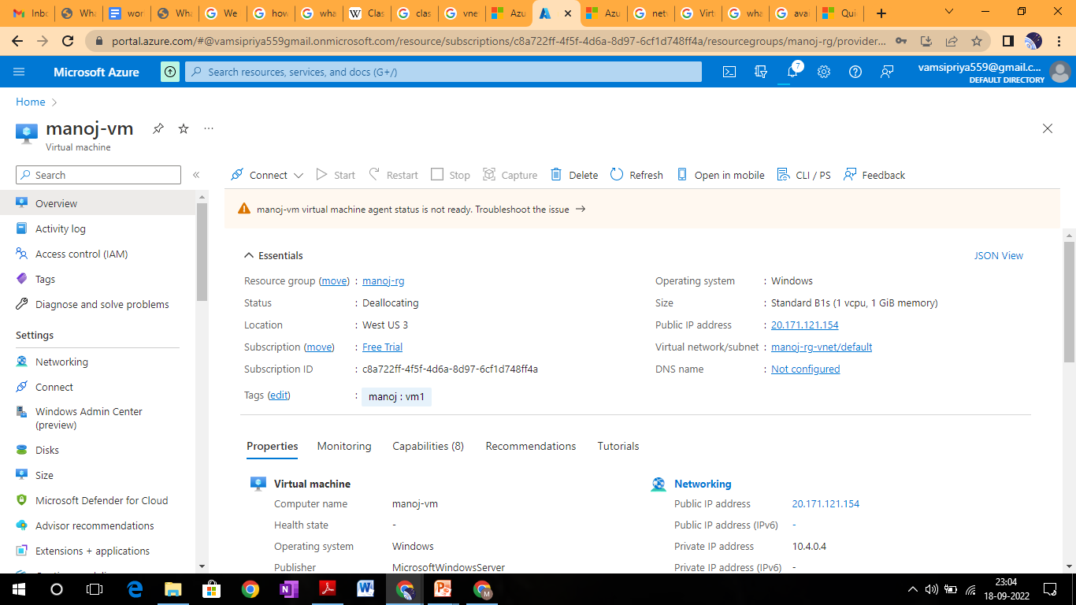

Slide 41
V-Net Peering
Virtual network peering enables you to seamlessly connect two or more Virtual Networks in Azure. The virtual networks appear as one for connectivity purposes.
The traffic between virtual machines in peered virtual networks uses the Microsoft backbone infrastructure. Like traffic between virtual machines in the same network, traffic is routed through Microsoft's private network only.

Slide 42
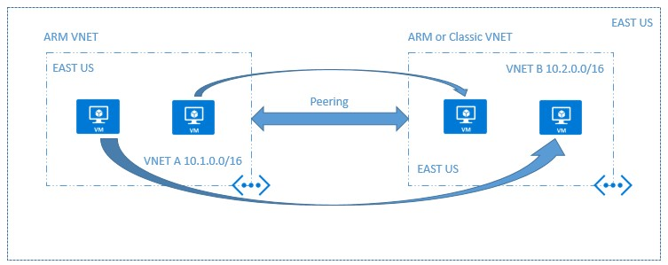
Azure supports the following types of peering:
Virtual network peering: Connecting virtual networks within the same Azure region.

Slide 43
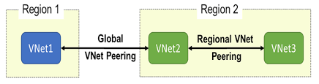
Global virtual network peering: Connecting virtual networks across Azure regions.

Slide 44
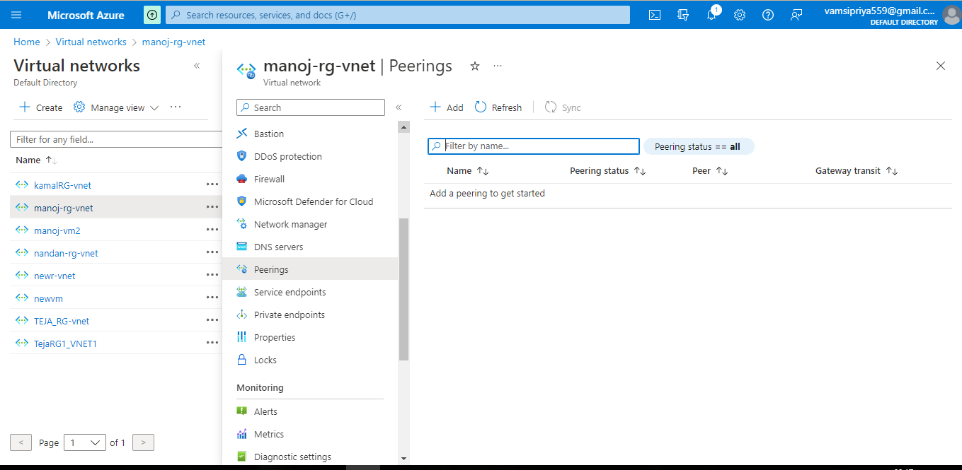
Lab2: Create V-Net Peering
Select Peerings under Settings and then select + Add.

Slide 45
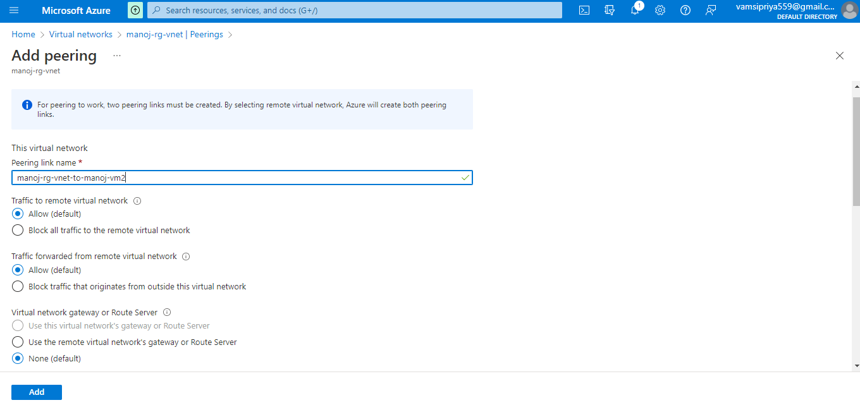
Enter or select values for the following settings:

Slide 46
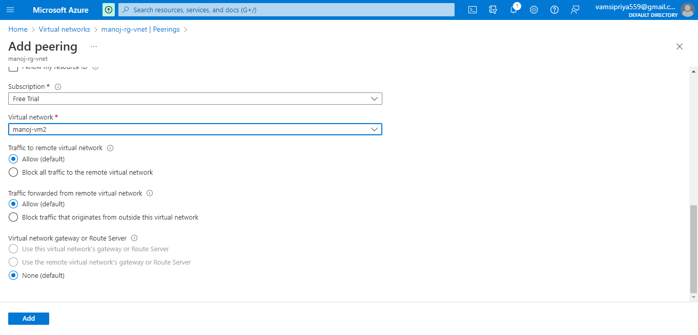

Slide 47
